Slide 1






E-COMMERCE ANALYSIS
Student Details
Name: Lokesh G
NM Id: aut513321105701
College Name: University College of Engineering - Arni

Slide 2
E-Commerce Analysis
Disclaimer
The content is curated from online/offline resources and used for educational purpose only

Slide 3

Course Outline
E-Commerce Analysis
Abstract
Problem Statement
Aims, Objective & Proposed System/Solution
System Deployment Approach
Model Development & Algorithm
Future Scope
Video of the Project
Conclusion
Reference

Slide 4


E-Commerce Analysis
Abstract
The program performs a comprehensive analysis of an e-commerce dataset to provide insights into business performance and customer preferences. It begins with data preprocessing to handle missing values, encode categorical data, and remove duplicate entries. Exploratory data analysis (EDA) includes visualizations such as histograms, boxplots, scatter plots, and heatmaps to understand relationships within the data.

Slide 5


E-Commerce Analysis
Problem Statement
The dataset consists of sales transactions from various categories of products and includes information such as sales revenue, profit, quantity sold, shipping cost, and other factors. The main focus is to explore how different factors such as sales, discount, and shipping cost impact profit. Additionally, the analysis aims to identify trends and patterns in the data, such as most sold products, monthly variations, and category-wise performance.

Slide 6

E-Commerce Analysis
Aim and Objective
Aim: The aim of this project is to leverage data from the U.S. e-commerce records of 2020 to perform comprehensive data analysis and develop predictive models that provide actionable insights for improving business operations and customer experiences in the e-commerce industry. Through this analysis, the project seeks to identify trends, patterns, and relationships within the data to inform strategic decision-making and optimize business processes.

Slide 7
E-Commerce Analysis
Objectives
Exploratory Data Analysis (EDA): Conduct a thorough analysis of the e-commerce dataset to understand the distribution and relationships of key features such as sales, quantities, categories, regions, and customer segments. This includes data cleaning, transformation, and visualization.
Predictive Modeling: Develop and train machine learning models, including linear regression and other advanced algorithms, to predict future sales and quantities based on historical data and identified patterns.
Model Evaluation and Performance Optimization: Evaluate the performance of different models using metrics such as accuracy, precision, recall, and F1 score. Optimize model parameters and features for improved performance and reliability.
Actionable Insights: Generate insights and recommendations for improving business operations, such as optimizing inventory management, streamlining supply chains, and personalizing customer experiences.
Data Visualization and Reporting: Create clear and informative data visualizations to communicate findings to stakeholders, enabling them to make data-driven decisions.
Future-Proofing the Model: Ensure the model can adapt to changing data patterns and incorporate new data sources to stay relevant and useful over time.

Slide 8

E-Commerce Analysis
Proposed Solution
Data Cleaning and Preprocessing: Clean the dataset by removing missing values and duplicates, converting date columns to appropriate data types, and normalizing numerical columns while handling outliers.
Exploratory Data Analysis: Use visualizations (histograms, boxplots, scatter plots, and heatmaps) to explore relationships between features, identify top-selling products and categories, and observe sales and quantity variations.
Model Building and Evaluation: Train and evaluate regression models (linear regression, K-Nearest Neighbors, decision trees, random forest) to predict profit, comparing performance using mean squared error and R-squared metrics.
Insights and Recommendations: Derive insights on the factors impacting profit and provide actionable recommendations to optimize operations and improve profitability.
Notes:
8

Slide 9
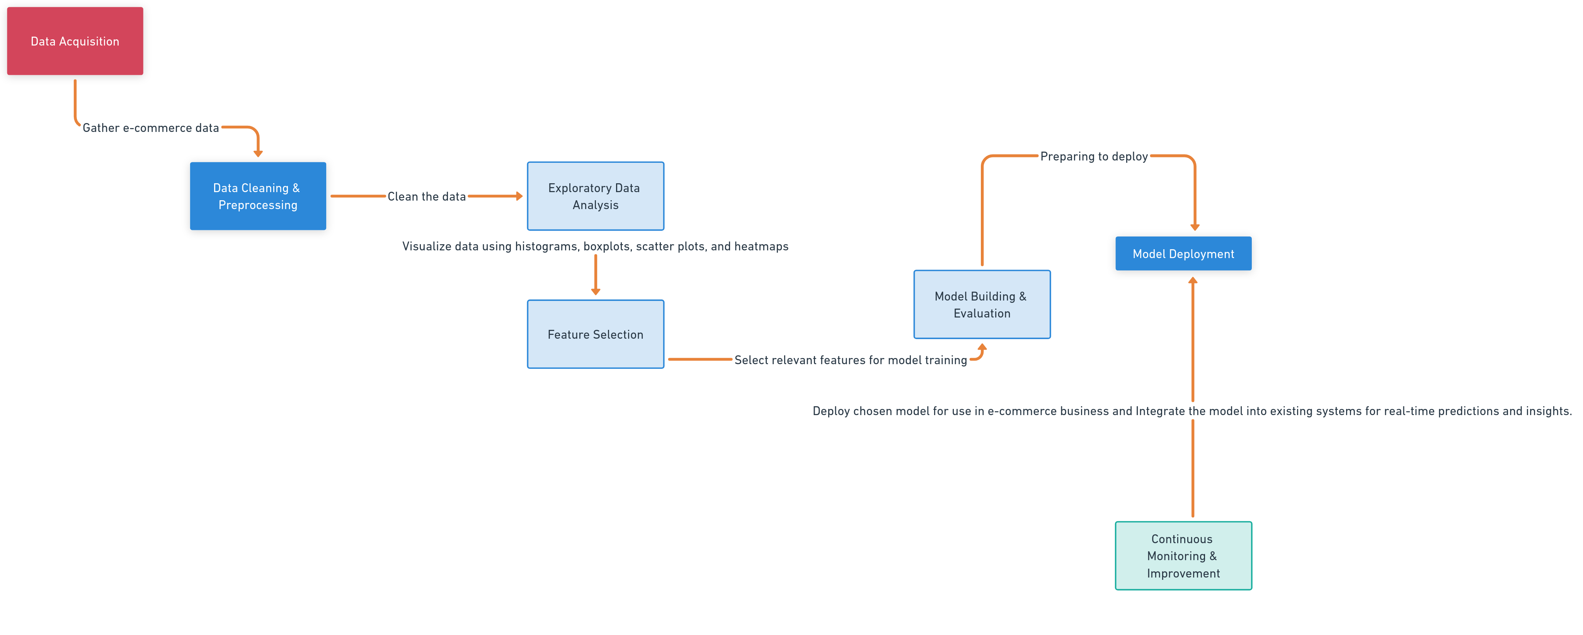
E-Commerce Analysis
System Deployment Approach
Notes:
9

Slide 10
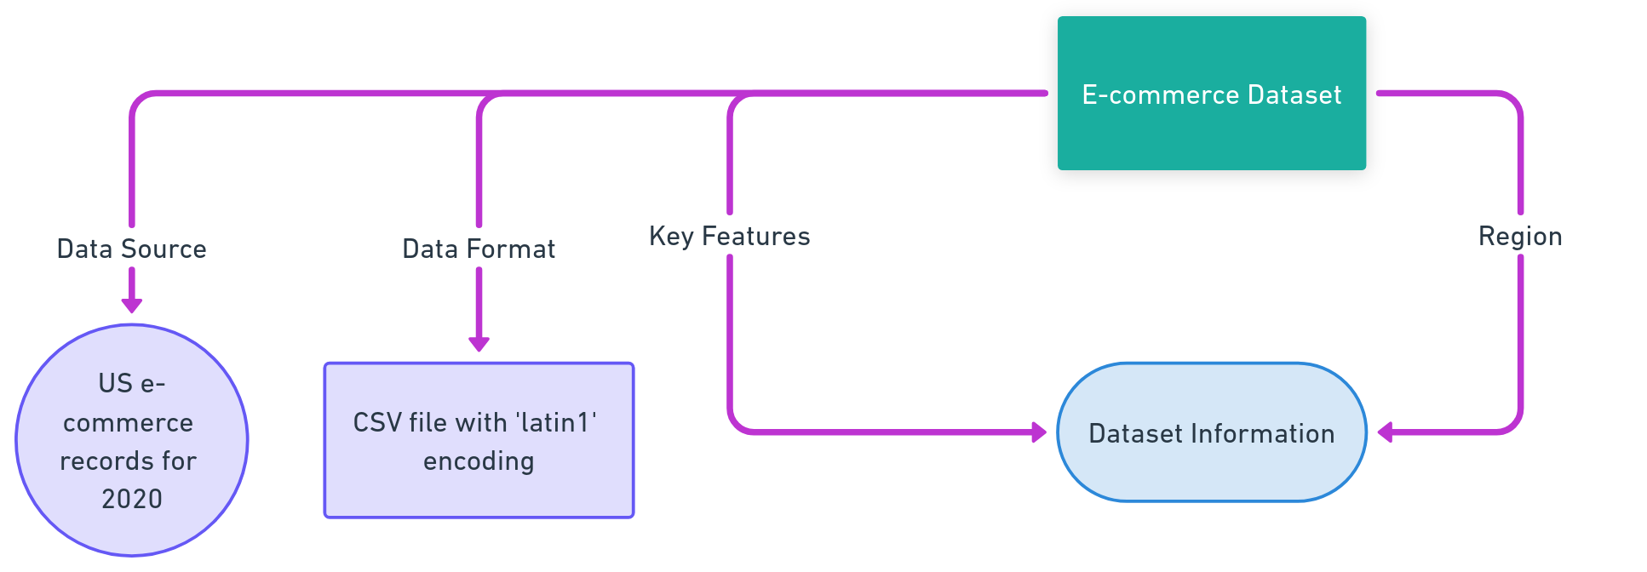
E-Commerce Analysis
Model Development & Algorithm
Dataset Description:
Notes:
10

Slide 11
E-Commerce Analysis
Model Development & Algorithm
Data Preprocessing and Feature Engineering:
Clean the data by removing missing values and duplicates.
Convert date columns to appropriate data types and extract relevant information such as month and day of the week.
Normalize numerical columns and handle outliers for better model performance.
Perform feature engineering to extract meaningful attributes such as customer segments, product categories, and sales metrics.
Feature Selection:
Identify and select the most relevant features such as sales, discounts, shipping costs, and customer segments that impact profit.
Use correlation analysis, mutual information, and feature importance from models to determine which features to use for model training.
Algorithm Selection:
Choose suitable algorithms for regression tasks, such as linear regression, K-Nearest Neighbors (KNN), decision trees, random forests, and gradient boosting.
Experiment with different algorithms and hyperparameter tuning to find the best-performing model.
Notes:
11

Slide 12
E-Commerce Analysis
Model Development & Algorithm
4.Model Training and Evaluation:
Split the dataset into training and testing sets.
Train the selected models on the training data, and tune hyperparameters for optimal performance.
Evaluate the models using metrics like mean squared error (MSE) and R-squared (R2).
Compare model performance to identify the best model.
5.Model Deployment and Continuous Improvement:
Select the best model based on evaluation results and deploy it for use in production.
Integrate the model with e-commerce business systems for real-time predictions.
Continuously monitor model performance and retrain the model with new data as needed to maintain and improve its accuracy and predictive power.
Notes:
12

Slide 13
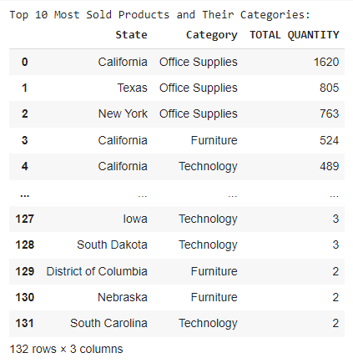
E-Commerce Analysis
Result
Notes:
13

Slide 14
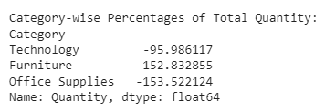
E-Commerce Analysis
Result
Notes:
14

Slide 15
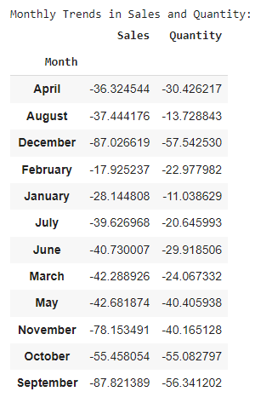
E-Commerce Analysis
Result
Notes:
15

Slide 16
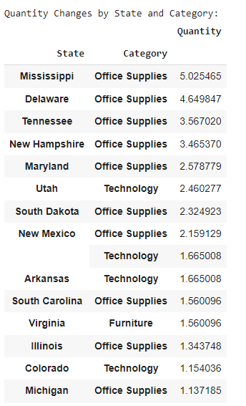
E-Commerce Analysis
Result
Notes:
16

Slide 17
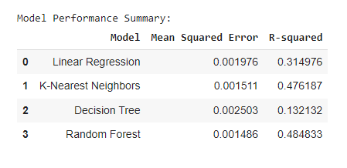
E-Commerce Analysis
Result
Notes:
17

Slide 18

E-Commerce Analysis
Future Scope
The future scope of this project includes integrating real-time data streams for up-to-date insights and predictive analytics to support dynamic decision-making. The system's capacity to handle larger datasets and more complex features will improve its predictive accuracy and robustness. Utilizing advanced machine learning algorithms such as deep learning and ensemble methods can enhance performance across diverse use cases. Incorporating customer feedback and market trends into the model can help anticipate future demands and preferences.
Notes:
18

Slide 19
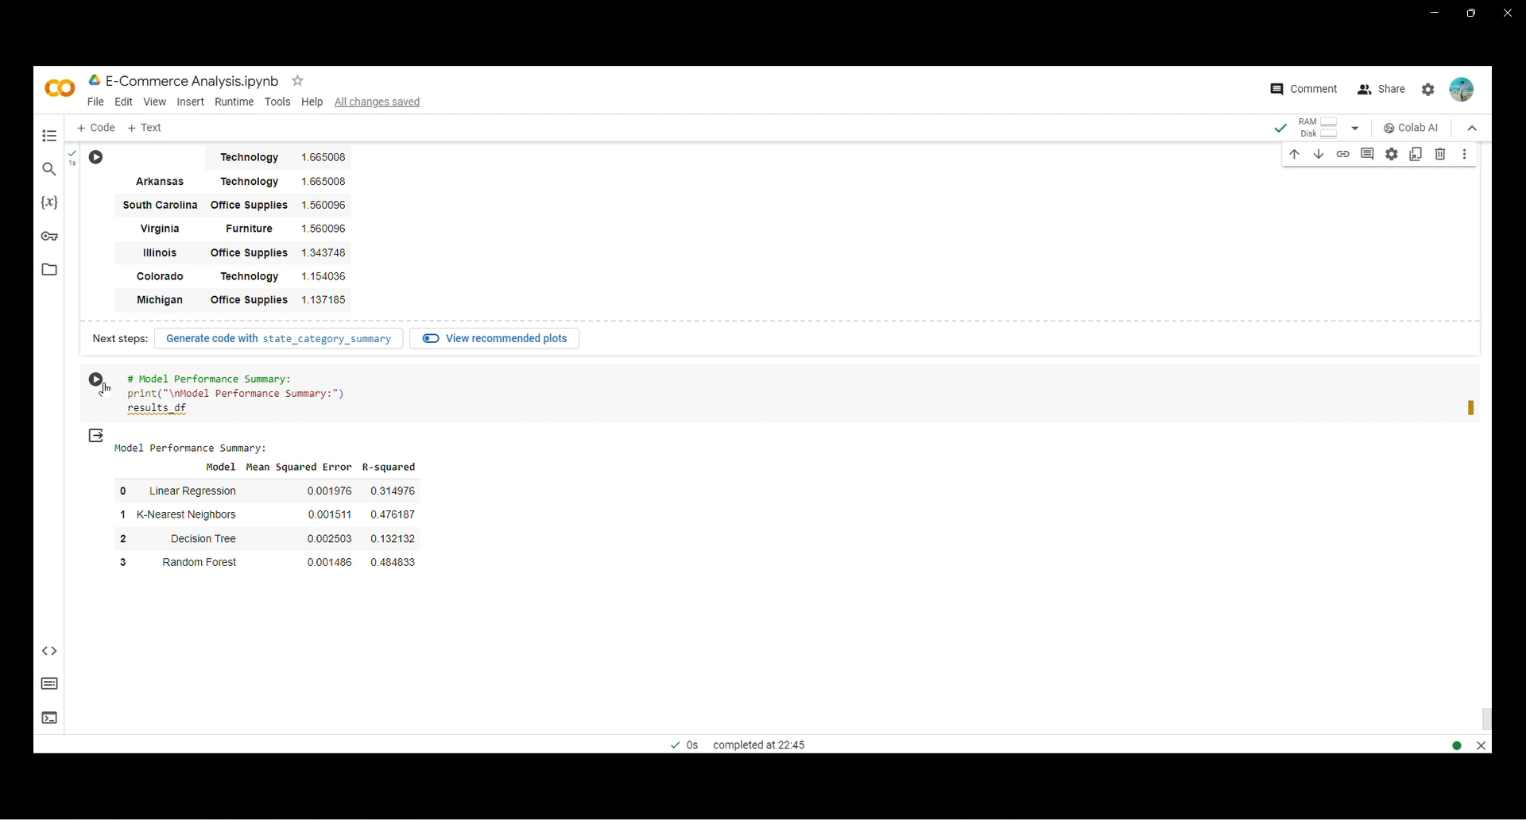
E-Commerce Analysis
Video of the Project
Notes:
19

Slide 20

E-Commerce Analysis
Conclusion
The project presents a comprehensive approach to analyzing and modeling data from a U.S. e-commerce dataset. Through exploratory data analysis, we gain valuable insights into patterns and relationships within the data, such as seasonal trends in sales and quantities, customer purchasing behaviors, and regional preferences. This analysis guides the development of predictive models, including linear regression and other machine learning techniques, to make informed predictions and improve business operations.
Notes:
20

Slide 21
E-Commerce Analysis
Reference
Project Github link (https://github.com/Loki-30G/E-Commerce.git), Lokesh G, 2024.
Project video recorded link (https://youtu.be/fA7Xy_GIN1U), Lokesh G, 2024.
Project PPT & Report github link (https://github.com/Loki-30G/E-Commerce/tree/main/Report%20and%20PPT), Lokesh G , 2024.
Project Dataset Github link (https://github.com/Loki-30G/E-Commerce/tree/main/Dataset), Lokesh G, 2024.
GIT Hub Link of Project Code:
https://github.com/Loki-30G/E-Commerce/tree/main/Code
Notes:
Reference
These are the references for this session.

Slide 22
E-Commerce Analysis
Thank you!
Notes:
22

